Slide 1
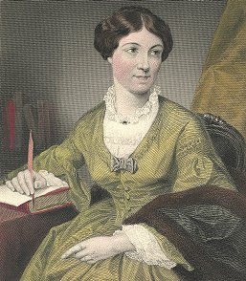
Harriet Martineau and Feminism
Gaby Weiner
July 2014
Liverpool, UK

Slide 2
Aims
to update the literature on Harriet Martineau’s work relating to the position of women in society;
to identify how her views on women changed over her lifetime; and
to re-evaluate her standing among feminist scholars.

Slide 3
Nobody can be further than I am from being satisfied with the condition of my own sex; under the law and custom of my own country...Often as I am appealed to, to speak, or otherwise assist in the promotion of the cause of Woman, my answer is always the same: - that women, like men, can obtain whatever they show themselves fit for. Let them be educated, - let their powers be cultivated to the extent for which the means are already provided, and all that is wanted or ought to be desired will follow of course. Whatever a woman proves able to do, society will be thankful to see her do, - just as if she were a man. If she is scientific, science will welcome her, as it has welcomed every woman so qualified.
Martineau, H. (1877) Harriet Martineau's Autobiography, London, Smith, Elder & Co., 1, 400-1.)

Slide 4
Literature
Typically associated with liberal feminism
Interested in the condition of women throughout life
Most consistently held views; dissatisfaction with the position of nineteenth-century women, importance of female education, respect for women's potential achievements; belief in the primacy of individual action
Nature of her radicalism
Textual positioning, of with masculine voice
Embeddedness in the ‘present’ and neglect by mainstream historians
Position in nineteenth-century feminism

Slide 5
Texts
Section entitled ‘the Political Non-Existence of Women’ in book Society in America published in 1837 when she was 35 and a rising star in London’s intellectual firmament.
Leaders written in 1853 and 1854 for the Daily News in support of divorce legislation.
Article entitled ‘Female Industry’ for the Edinburgh Review in 1859 about the dismal conditions of women workers in Britain
Four letters written in 1863-4 for the Daily News in support of the repeal the Contagious Diseases Acts legalising medical inspections of women in military towns.

Slide 6
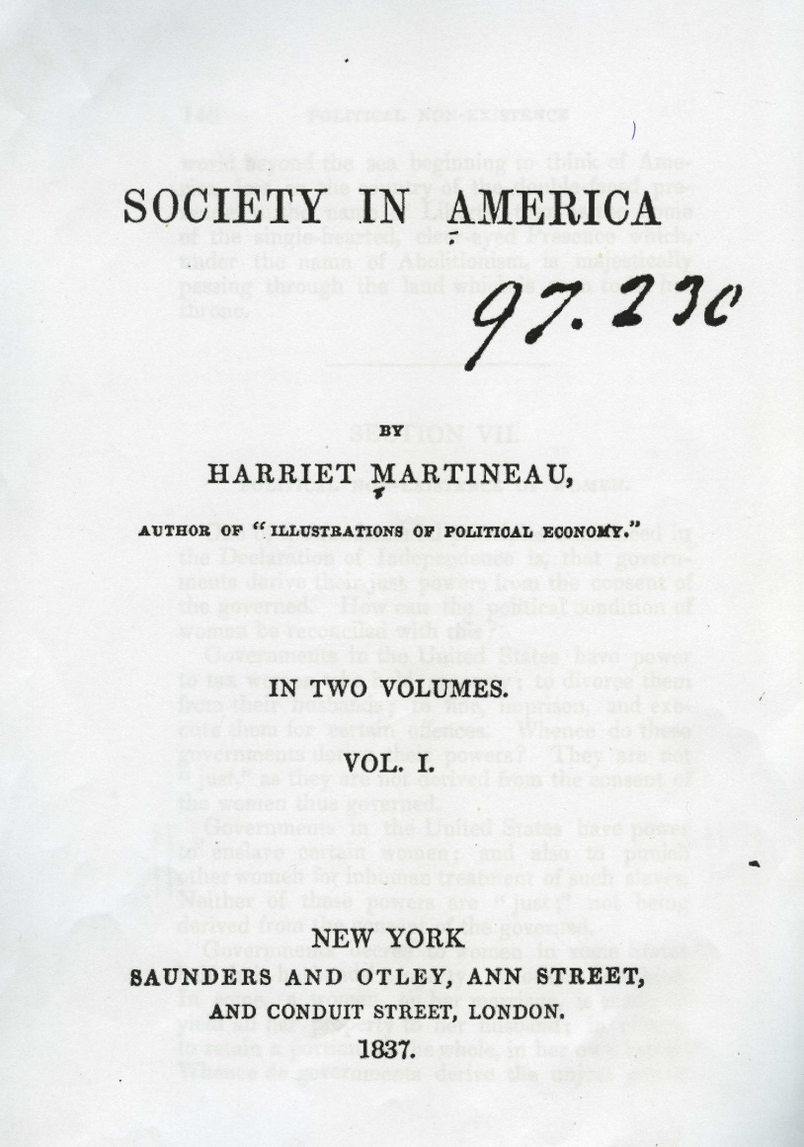
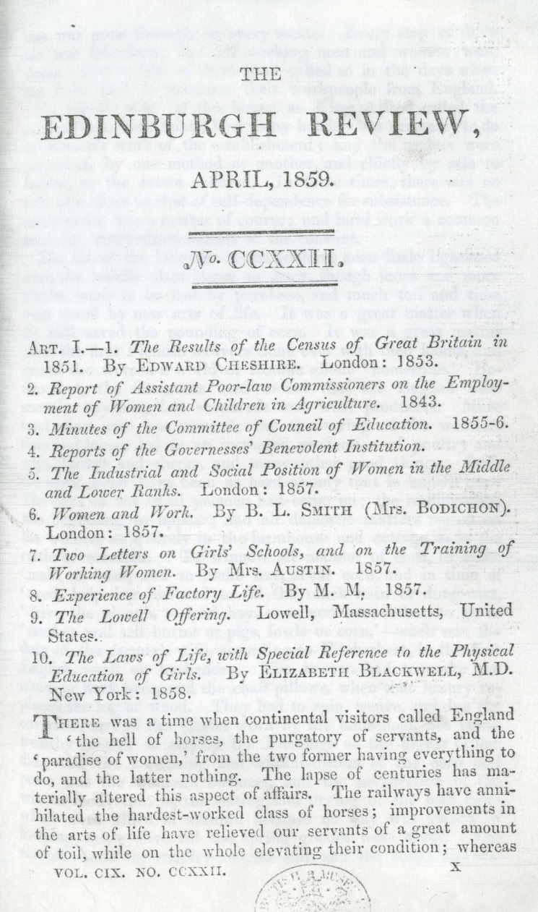

Slide 7
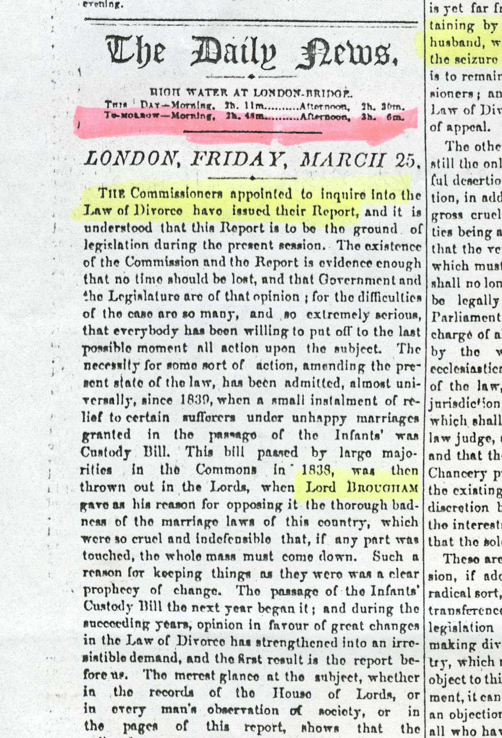
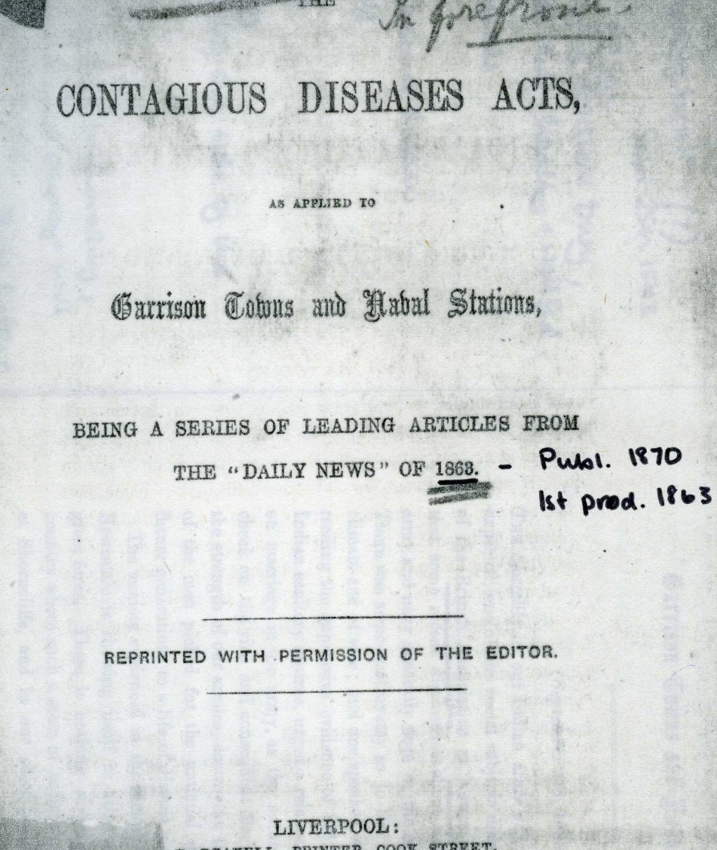

Slide 8
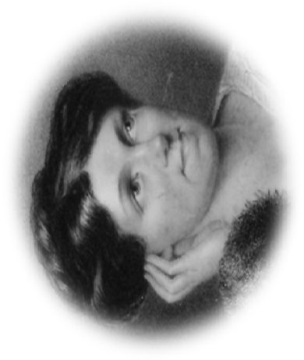

Slide 9
Women’s Political Rights
Governments in the United States have power to tax women who hold property; to divorce them from their husbands; to fine, imprison, and execute them for certain offences. Whence do these governments derive their powers? They are not “just”, as they are not derived from the consent of the women thus governed.
~~~~~~
The principle of the equal rights of both halves of the human race is all we have to do with here. It is the true democratic principle which can never be seriously controverted, and only for a short time evaded. Governments can derive their just powers only from the consent of the governed

Slide 10
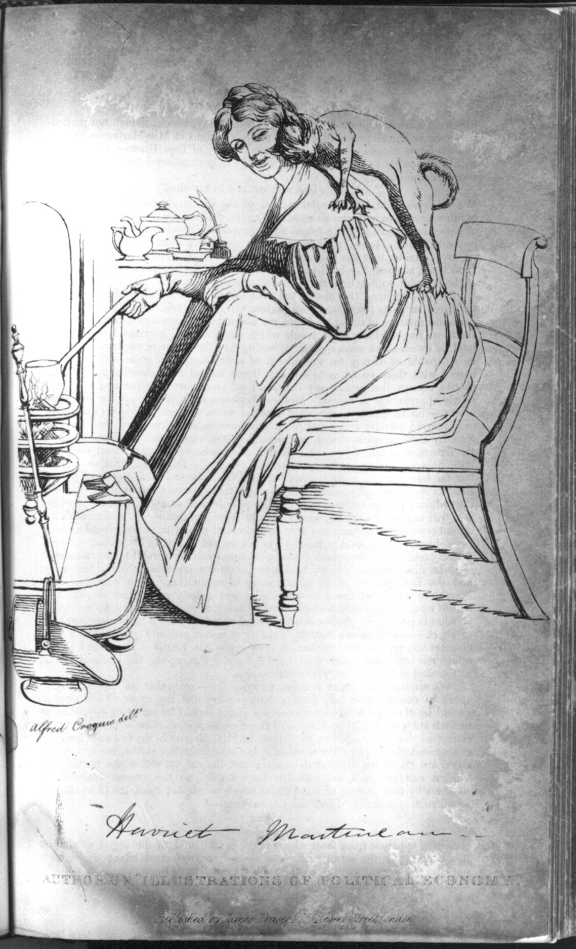

Slide 11
Marriage and Divorce
In Scotland, there were ninety-five cases in the five years from 1836 to 1841, while in England there have been 110 from the first day of this century until now. Of the ninety-five Scotch divorces, one third were at the suit of the wife; whereas in England the wife cannot seek a divorce at all, except in cases of unnatural atrocity; so that only four successful suits are on record. In Scotland, the parties in the ninety-five cases were almost all from the labouring classes, the expense being from £15 to £30, whereas in England, divorce is wholly out of the reach of all but the rich - the expense rising from £500 to many thousands.

Slide 12
Marriage and Divorce
By the changes in our marriage law much more happiness is caused than belongs to the mere relief of a certain number of sufferers, hitherto hopeless …We shall hear no more of the absolutely unendurable cases; and for all the hardest there is more or less remedy now provided.
The benefit...under the reform of our marriage law is the full, practical recognition of women as "breadwinners"...But the fact is, and has been, that a vast proportion - some say nineteen-twentieths - of the women of the kingdom work for their bread, although our laws remain applicable to a very different state of society, to a social state in which nearly every woman was maintained by husband, father, mother or kinsman

Slide 13
Employment Opportunities for Women
So far from our country-women being all maintained as a matter of course by us, the breadwinners, 3 million out of 6 [million] adult women work for subsistence; and two out of three for independence - we must improve and extend education to the utmost; and then open a fair field to the powers and energies we have educed. This will secure our welfare nationally and in our homes
~~~~~~~~~
In other words, we must improve and extend education to the utmost; and then open a fair field to the powers and energies we have educed. This will secure our welfare, nationally and in our homes, to which few elements can contribute more vitally and more richly than the independent industry of our countrywomen.

Slide 14
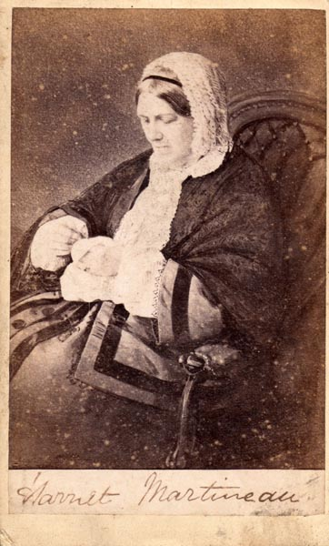

Slide 15
The Contagious Diseases Acts
This admission of the necessity of the vice is the point on which the whole argument turns, and on which irretrievable consequences depend. Once admitted, the necessity of a long series of fearful evils follows of course. There can be no resistance to seduction, procuration, brothels, disease and methods of regulation, when once the original necessity is granted. Further, the admission involves civil as well a military society, and starts them together on the road which leads down to what the moralists of all ages and nations have called the lowest hell. (Original emphasis)
(Martineau, 1863, 20 September)

Slide 16
HM and Feminism
Chosen texts affirm HM’s position as feminist theorist
Writing focused on every aspect of women’s lives whether auto/biographical, concerning travel or about social or political life
Liberal feminist
Rejected ‘woman on a pedestal’ in favour of equal treatment and rights
Aware of potential reversal by CD Acts of gains previously made
Powerful and ‘delicate’ nature of CD letters in 1863 restored fading reputation as feminist

Slide 17
Contact Details
Gaby Weiner
gaby.weiner@btinternet.com
www.gabyweiner.co.uk

